Slide 1

TILT
A Smart Pill Container
Janine Heiser | Faith Hutchinson | Matt Valente

Slide 2
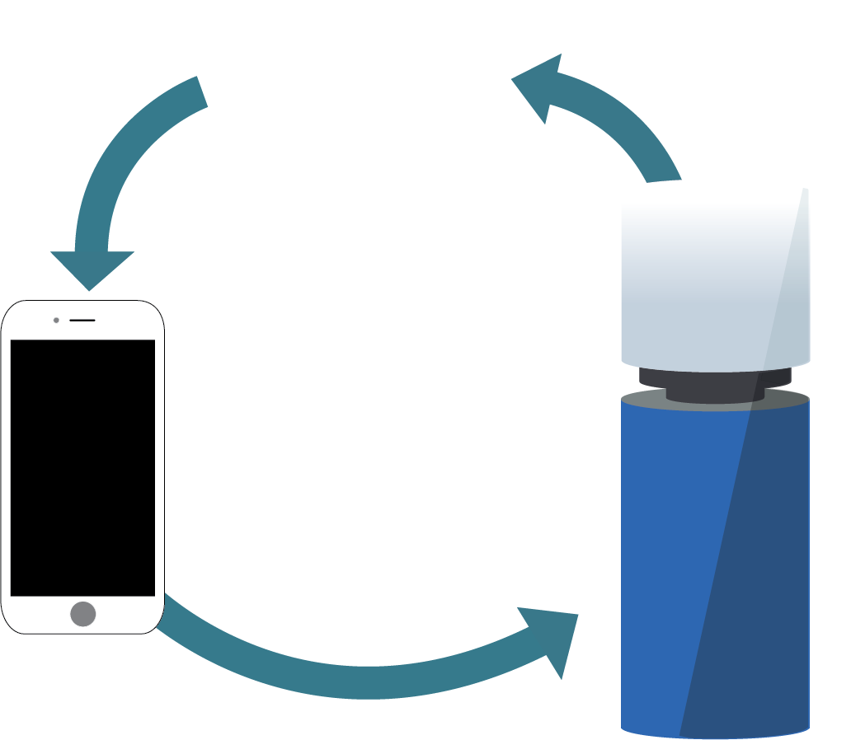
IDEA
We are creating an ambulatory device that communicates to a user, and if desired, a user’s loved one, whether he or she is properly taking his medicine.
Notes:
FAITH
The vessel will be embodied in two compartments: a cup which can be filled with water so the user can easily take his pills and a lid which will act as a container for a full day’s dose of medicine. We expected to be able to measure biorhythms, but that was tricky.

Slide 3
USER
HE OR SHE IS . . .
Our user is a person who would like support in remembering to take his medication.
HE OR SHE IS NOT . . . He is not someone who refuses to take his medication.
Notes:
[FAITH]

Slide 4
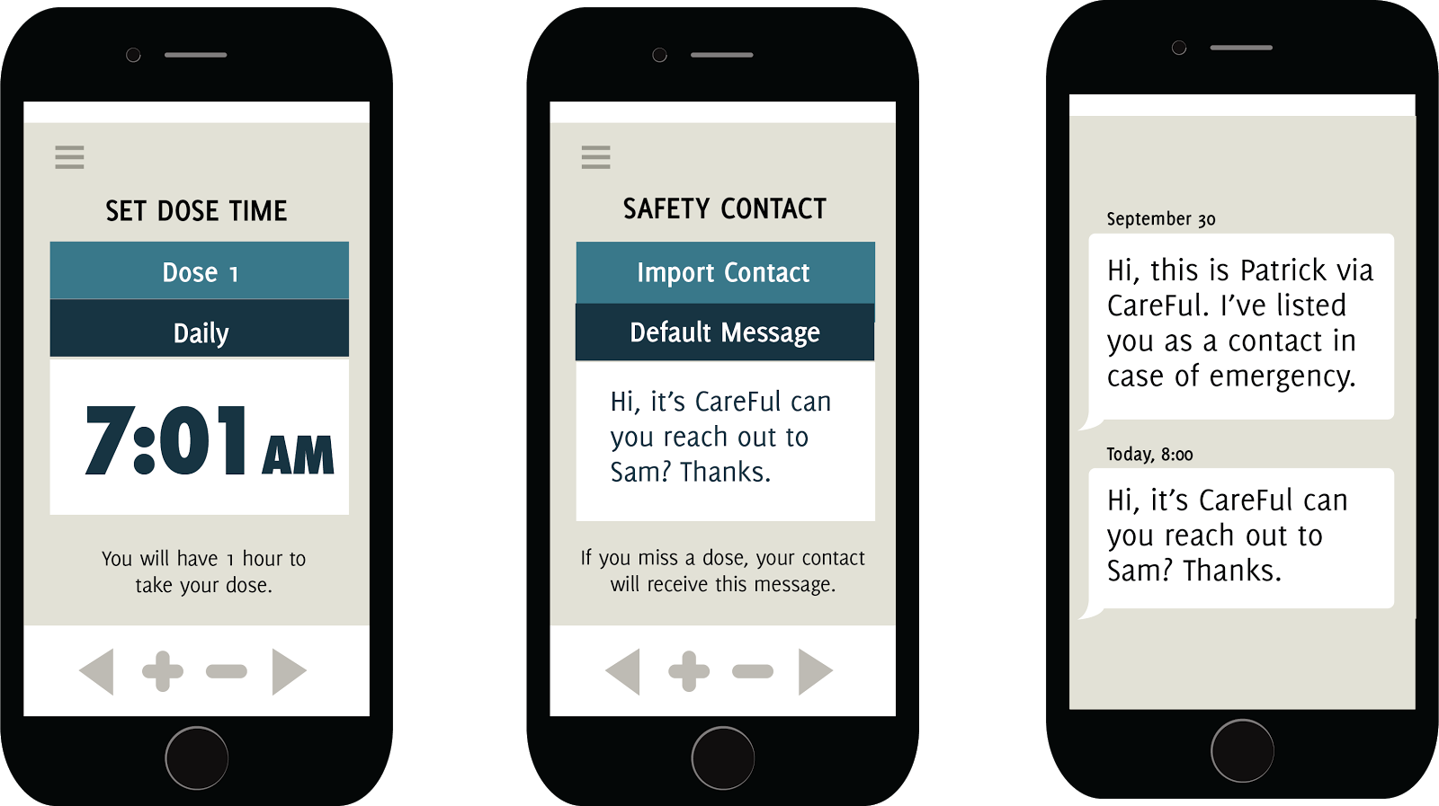
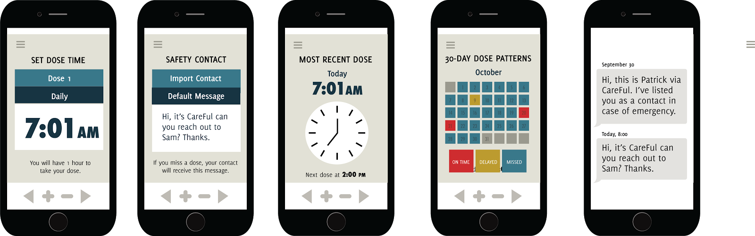
PROCESS (mobile portion)
Notes:
[FAITH OR/AND MATT]
user sets dose time on app
user sets safety contact on app
if user misses a dose, auto message to safety contact

Slide 5
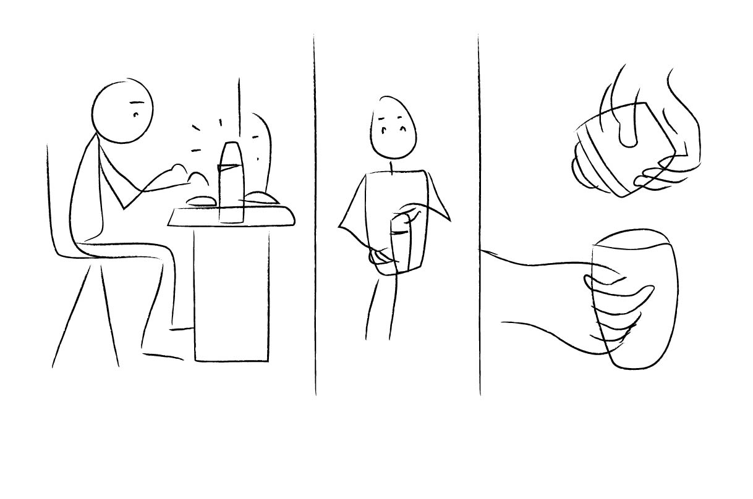
PROCESS (device portion)
SYS_OUT:
WHILE dose time: lid emits ambient notice.
USER_ACT: Unscrew vessel
SYS_IN:
USER_ACT: Remove top.
SYS_IN:
Sensor reads motion
Notes:
[FAITH OR/AND MATT]
First the lid must be removed from the vessel, and a tilt sensor will indicate the inversion of the lid, thus signaling the beginning of a chain of events;

Slide 6
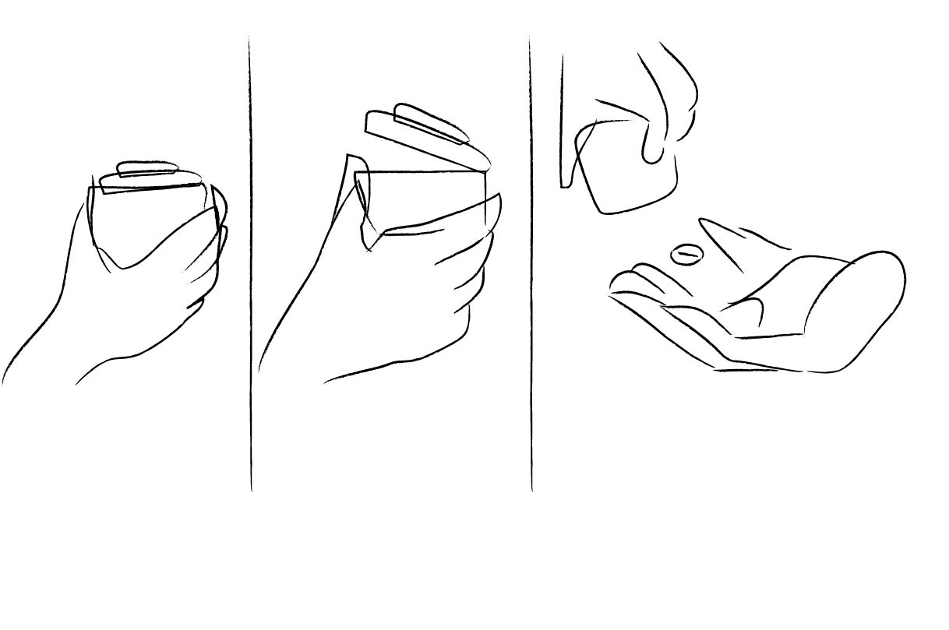
PROCESS (device portion)
SYS_IN:
IF position == True:
SYS_IN:
IF sensor == True
SYS_IN:
IF sensor == True
Notes:
[FAITH OR/AND MATT]
next the lid must be opened in order to retrieve the pills, and photocells lining the lid will serve to indicate that a pill has been removed;
then the water in the cup portion of the vessel must be imbibed to complete the action sequence, and this will be measured by using another gyroscope to note that the cup has been tilted.

Slide 7
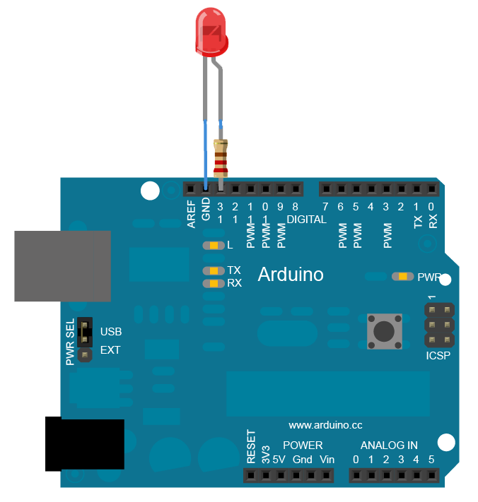
HARDWARE
Using Arduino and sensors, to measure a series of actions, we are approximating whether or not a user has taken his meds.
Notes:
[MATT]
key OBSTACLE or RESULT

Slide 8

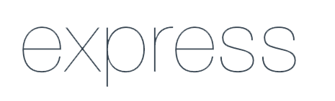
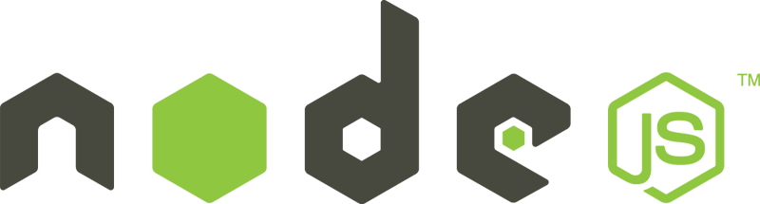

SOFTWARE STACK
Johnny-Five.js
JS library to communicate with Arduino
https://github.com/rwaldron/johnny-five
Express & node.js
Handles get and post requests coming from pill bottle sensors and users, and coordinates with the DB
MongoDB
Holds pill sensor data, user data and other application information.
Notes:
[JANINE]
Potentially demo the device here. Possible extensions- refine query strings/ make searching for user data more robust. User authenication via the api.

Slide 9
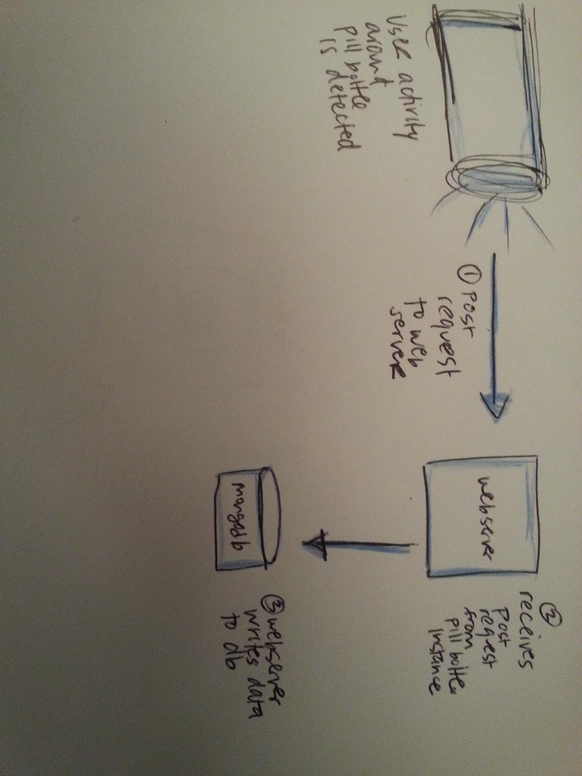
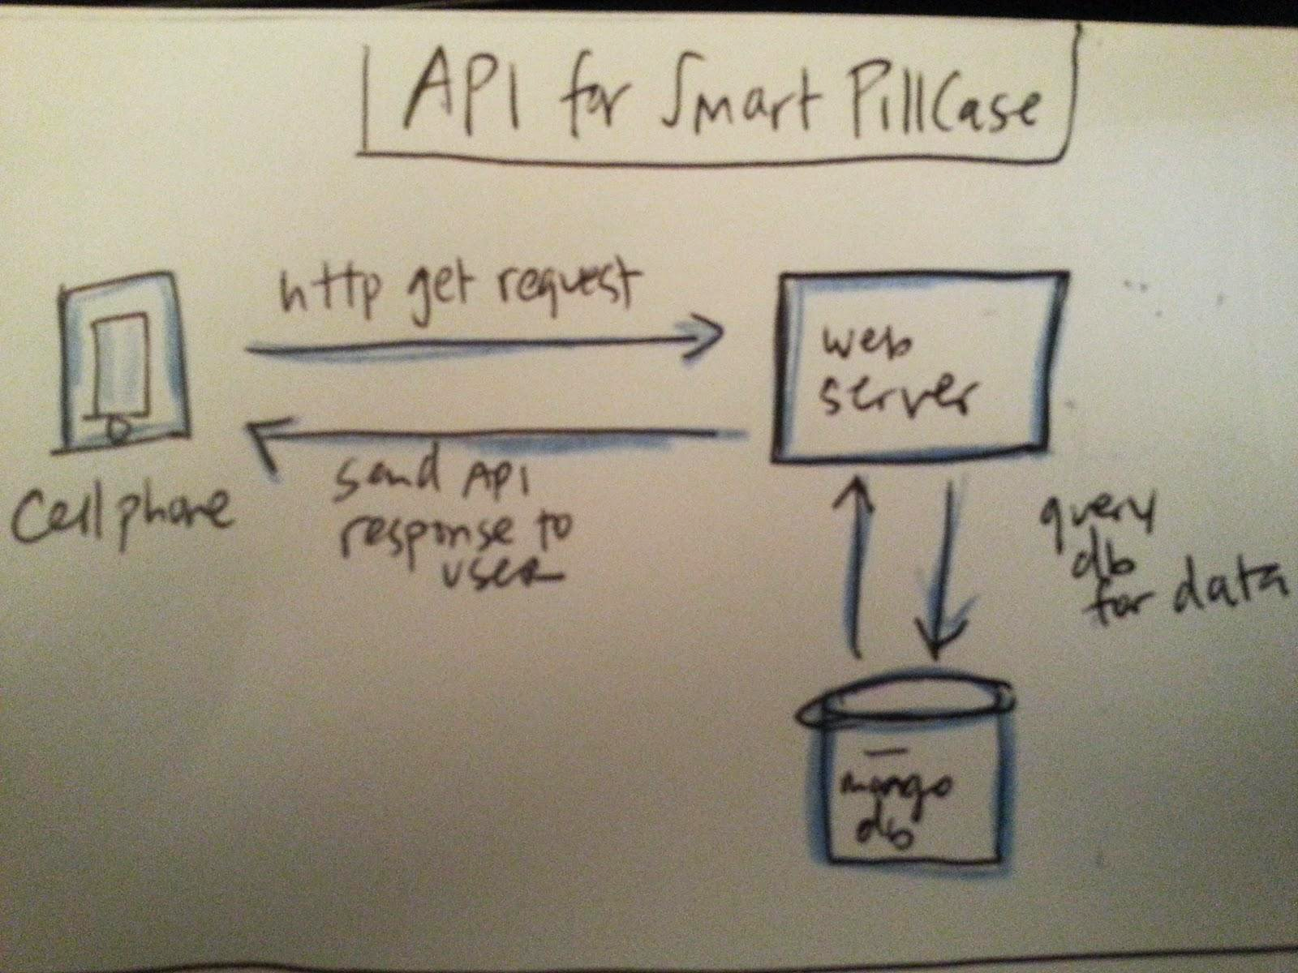
PROCESS (server side)
Handling Get and Post Requests on Tilt’s API
Notes:
[JANINE]

Slide 10
DEMO
Notes:
[FAITH OR/AND MATT]
next the lid must be opened in order to retrieve the pills, and photocells lining the lid will serve to indicate that a pill has been removed;
then the water in the cup portion of the vessel must be imbibed to complete the action sequence, and this will be measured by using another gyroscope to note that the cup has been tilted.

Slide 11
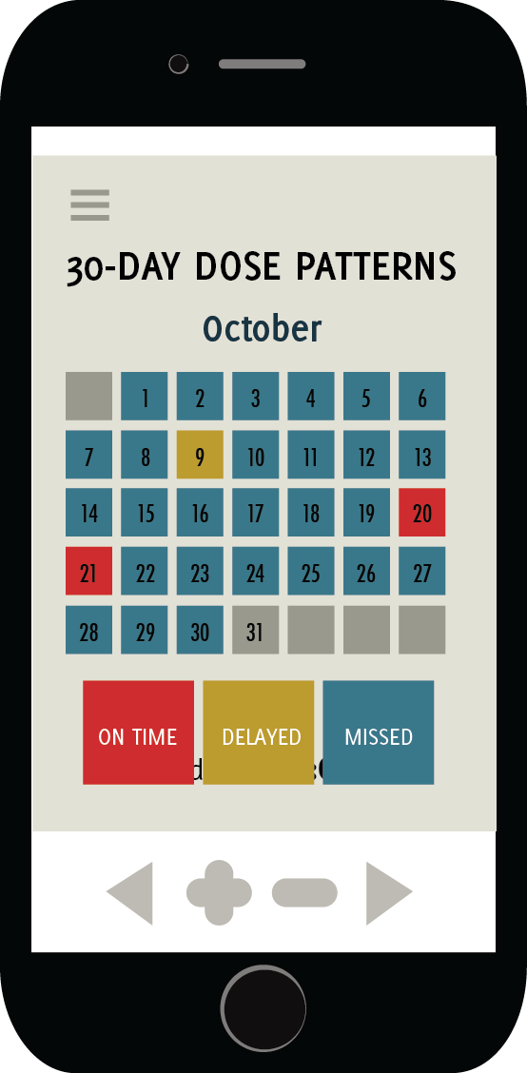
EXTENSIONS
Data Visualization
Could be combined with other, external data collection to make a holistic health
Authentication
Make sure the right person is taking the right medicine with two-step id.
Notes:
[MATT]

